Slide 1
CarFinder HUB
Ahmad Harmoush
Maher Mezher
Mohammad Absi Supervisor : Dr May Itani
Abed El Rahman Markiz

Slide 2

ACKNOWLEDGMENTS

Slide 3
Table of Contents
01
INTRODUCTION
02
LITERATURE REVIEW
03
FEASIBILITY STUDY
04
IMPLEMENTATION
05
METHODOLOGY
06
WORK PLAN
07 CONCLUSION

Slide 4
01 INTRODUCTION

Slide 5

PROBLEM IDENTIFICATION
Inconsistent Pricing
Fragmented Data
Outdated Listings
Limited Transparency
No Visual Aid

Slide 6


PROJECT GOAL
Real-Time Price Tracking
Unified Platform
Trust System

Slide 7
02 LITERATURE REVIEW

Slide 8





EXISTING SYSTEMS

Slide 9

EXISTING SYSTEMS
Platform | Real-Time Price Updates | Multi-Dealer Integration | Virtual Car Tours | User Reviews | Selling Feature
CarDekho | Yes | Limited | No | Yes | No
Edmunds | Yes | Yes | No | Yes | No
Dubizzle | Manual Updates | No | No | No | Yes
Facebook Marketplace | Manual Updates | No | No | No | Yes
Carwale | Yes | Limited | No | Yes | No
CarFinder HUB | Yes | Yes | Yes | Yes | Yes

Slide 10
03 FEASIBILITY STUDY

Slide 11




SURVEY
Gender
Occupation
Student
66.7%
Employee
11.8%
Age
Other
21.5%
18-34
88.4%
35+
11.6%

Slide 12
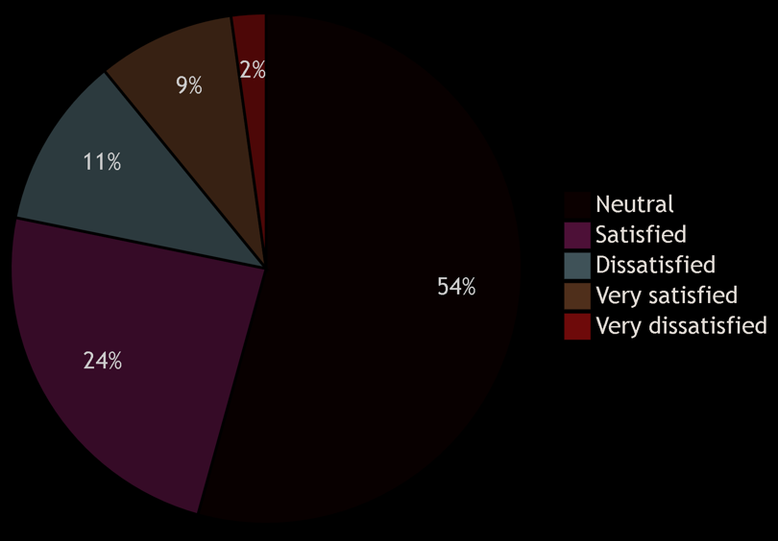
How satisfied are you with current car-selling platforms?

Slide 13
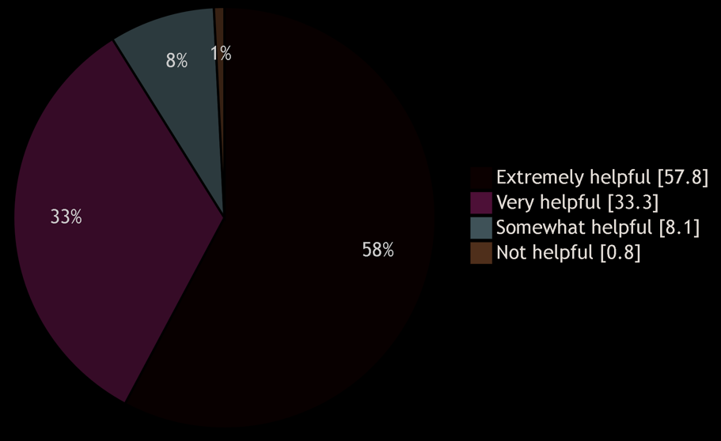
How helpful would it be if the app could show cars from multiple well-known selling platforms in one place?

Slide 14
THE SCOPE OF THE
FEASIBILITY STUDY

Slide 15






STAGE 1
STAGE 2
Society’s needs
Cost needed
Stakeholders
Potential markets
Establishing The goal

Slide 16
ECONOMIC FEASIBILITY
Development cost: $10,000-$25,000
Legal and Compliance: $2,000-$5,000
Hosting and Infrastructure: $5,000-$10,000
Operational Costs: $2,000-$5,000
Marketing and Advertising:
$3,000-$8,000
Per year

Slide 17
BREAK EVEN ANALYSIS
Year | Cost ($) | Cumulative Costs ($) | Benefits ($) | Cumulative Benefits ($)
1 | 26,500 | 26.500 | 15,000 | 15,000
2 | 28,000 | 54,500 | 30,000 | 45,000
3 | 27,000 | 81,500 | 50,000 | 95,000
4 | 30,000 | 111,500 | 100,000 | 195,000
5 | 40,000 | 151,500 | 150,000 | 345,000

Slide 18
04 METHODOLOGY

Slide 19
Scrum SDLC Model
Iterative development
Continuous Improvement
Flexibility
Simplicity
Time
Management

Slide 20




FUNCTIONAL REQUIREMENTS
User Management
Car Comparison Feature
Car Listing Management
Advanced Search and Filtering
User Review and Rating System
Secure Authentication and Verification

Slide 21


NON-FUNCTIONAL REQUIREMENTS
Performance and Scalability
Security and Data Protection
Usability and User Experience
Reliability and Availability
Legal Standards
Real Time Bidding Performance

Slide 22
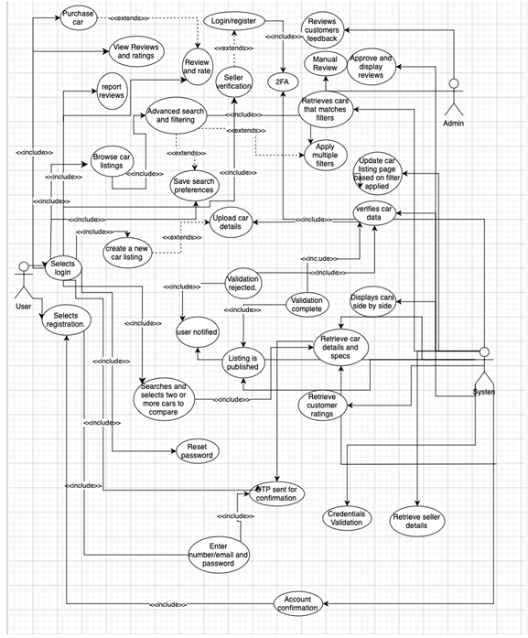
Use Case Diagram

Slide 23
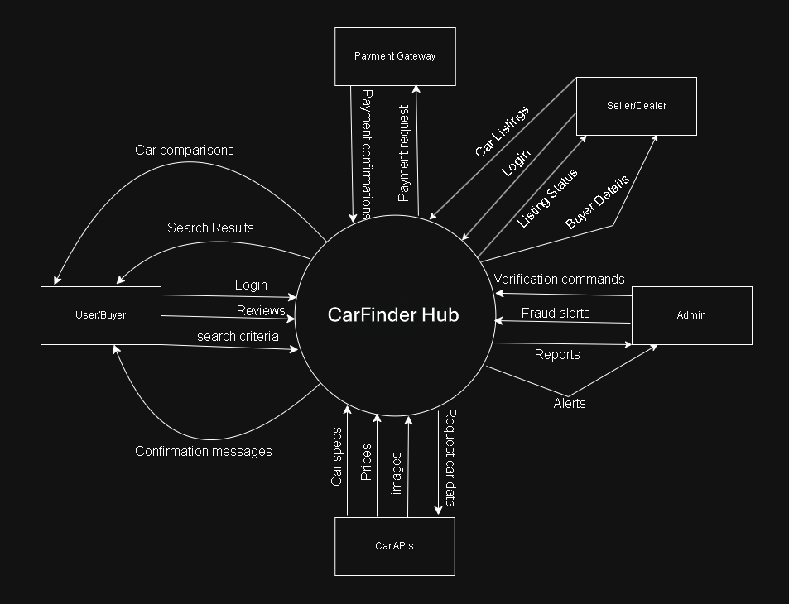
Data Flow
Diagram
Level 0

Slide 24
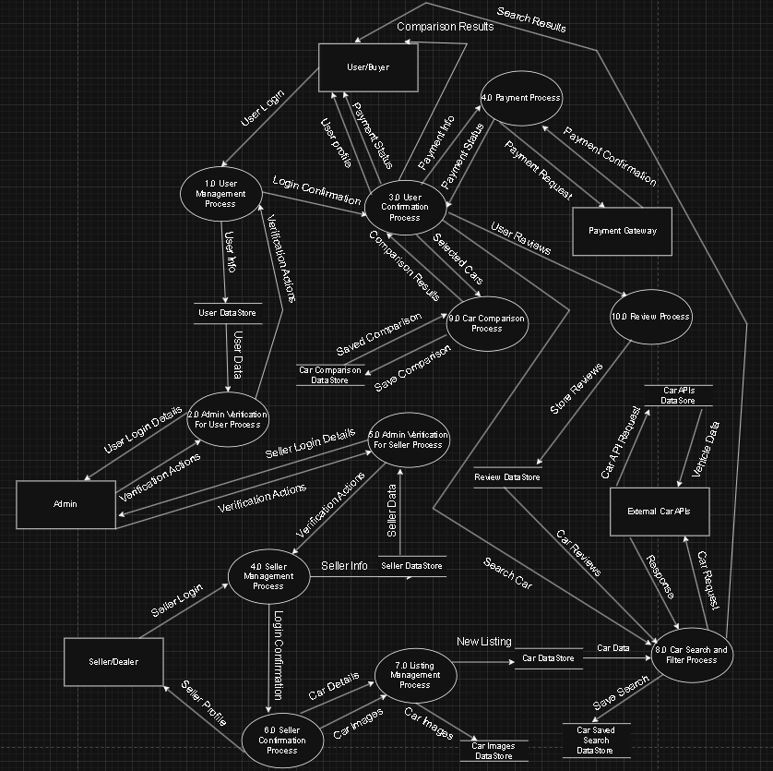
Data Flow
Diagram
Level 1

Slide 25
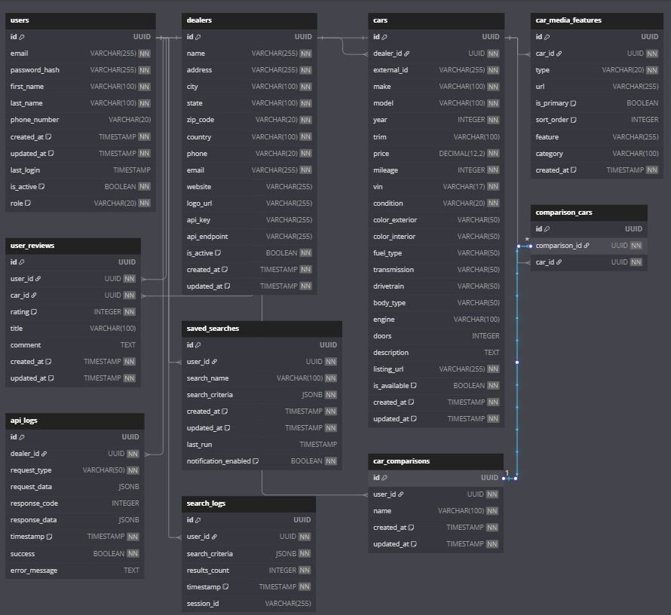
Database
Diagram

Slide 26
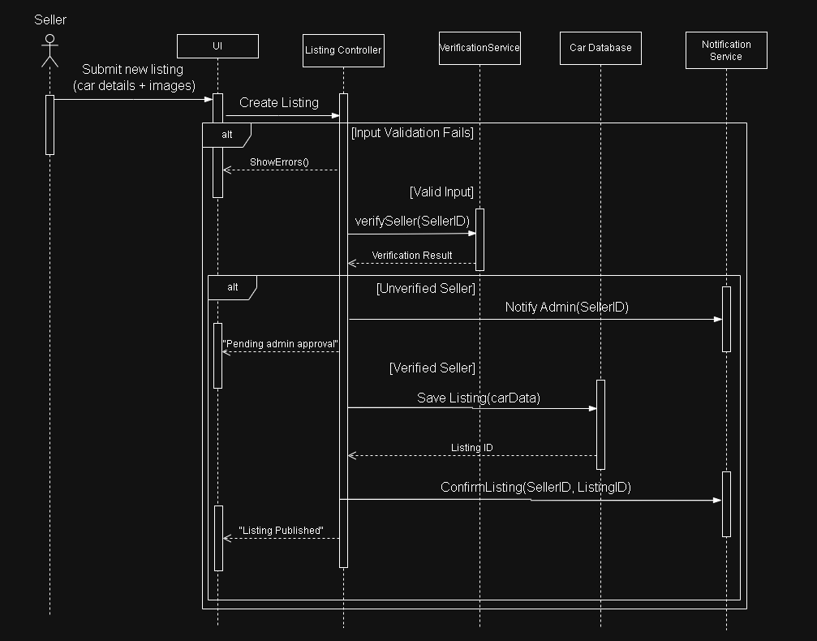
Car Listing and Management Sequence Diagram

Slide 27
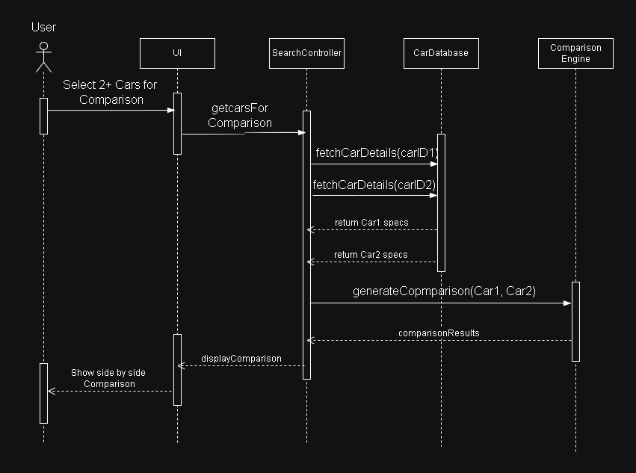
Car Comparison
Sequence Diagram

Slide 28
05 IMPLEMENTATION

Slide 29






Languages, Tools, Managers, Packages

Slide 30






Slide 31






WHY ANDROID STUDIO?
Firebase And API Integration
Quick And Simple
Advanced Debugging
Really Flexible
Rich Feature Set
Easy To Use

Slide 32
PROTOTYPE

Slide 33
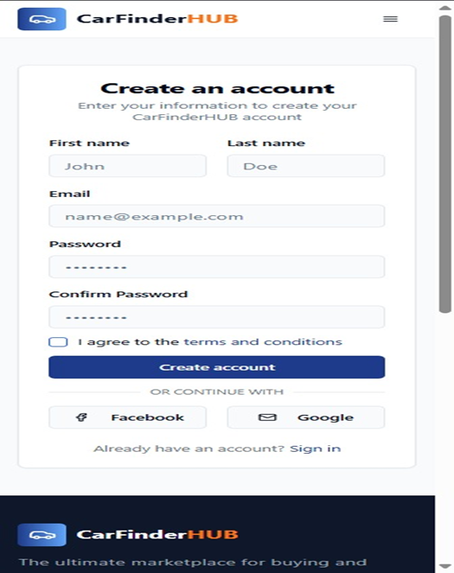
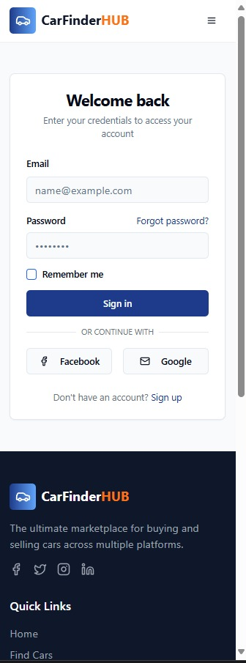
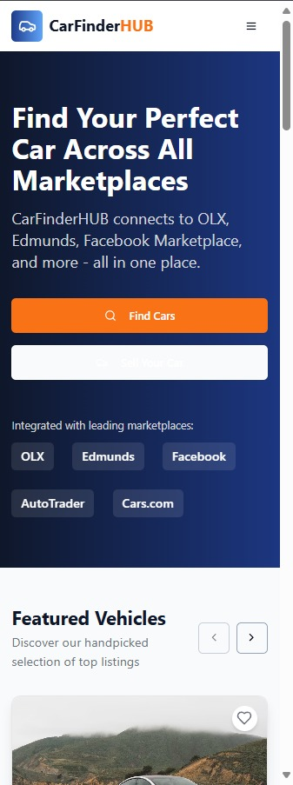
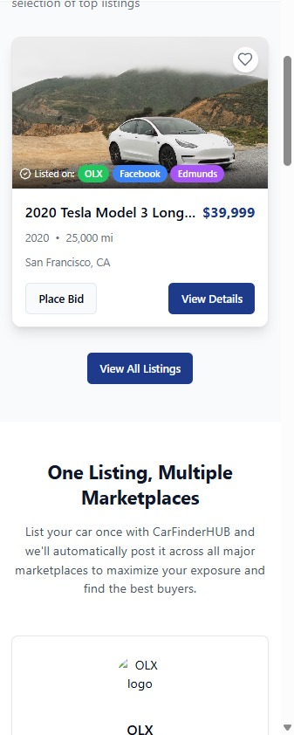

Slide 34
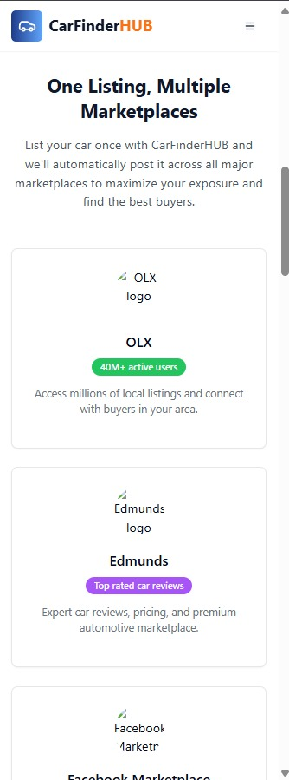
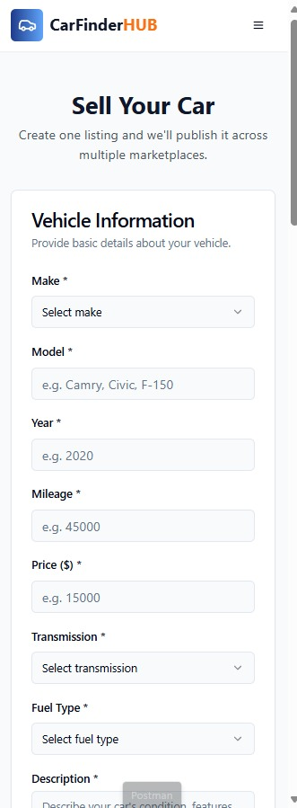
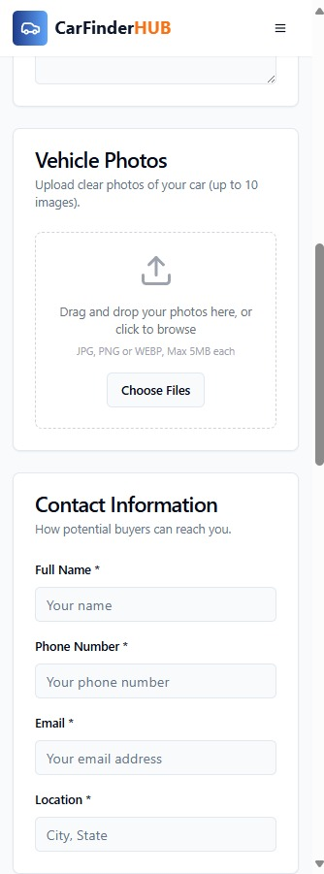
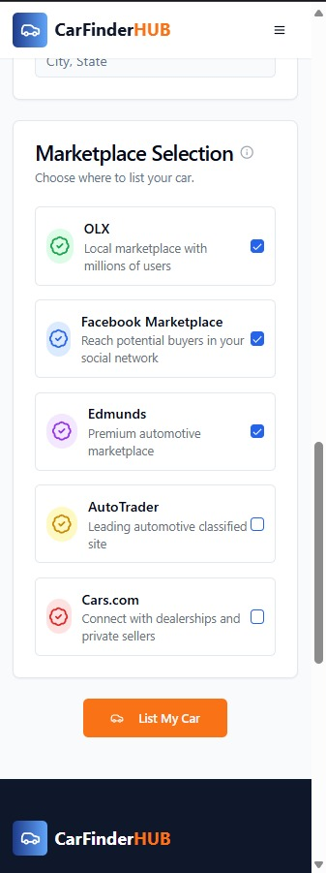

Slide 35
06 WORK PLAN

Slide 36
SOFTWARE ENGINEERING
Software Engineering | 20 days
Requirement Analysis | 11 days
Use Case Diagram | 3 days
DFD Diagram | 5 days
Database Diagram | 6 days
Sequence Diagram | 3 days

Slide 37
IMPLEMENTATION
Implementation | 90 days
Database Implementation | 5 days
APIs Implementation | 10 days
Front-end Implementation | 25 days
Back-end Implementation | 25 days
Testing | 15 days
Debugging | 10 days

Slide 38
07 CONCLUSION

Slide 39


CONCLUSION AND CONTRIBUTION FUTURE WORK/ENHANCEMENTS
Live Auctions
Add Verified Features
AI Price Predictions
Blockchain Verification

Slide 40
CarFinder HUB bridges the gap between convenience and confidence in car buying, leveraging technology to simplify decisions
Thank You

